Slide 1
Attracting New Members
Publicity Chairman Training
Friday, October 18, 2024
Presented by: Kevin King HLM; 2-time PBS
SIR Branch 95 (El Dorado Hills)

Slide 2
Introduction
Like many branches, Gold Country Branch 95’s (El Dorado Hills) saw steady decline from its membership high of 145
Reached a post-COVID low of 68 members at the end of 2021
Some at State considered our branch destined to fail
Beginning in 2022 – present, we’ve added 1 to as many as 6 new members every month but one
Currently, 105 members with an additional five prospective members in the pipeline

Slide 3
A Few Quick Facts
Approx. 5,700 men 50-79* live in El Dorado Hills (SIR target group)
~1.0% of Branch 95 members and 1.3% of all of SIR come from El Dorado Hills
Less than 2 of every 100 men in El Dorado Hills' target group join SIR
Similar results for many branches
WHY???
“SIR is the best kept secret.”
* Data sources include the United States Postal Service, U.S. Census Bureau, Yahoo, and the IRS

Slide 4
The Power of Getting the Word Out
A coordinated advertising plan and strong web presence has contributed to our recent success
There are many free or relatively low-cost resources available

Slide 5
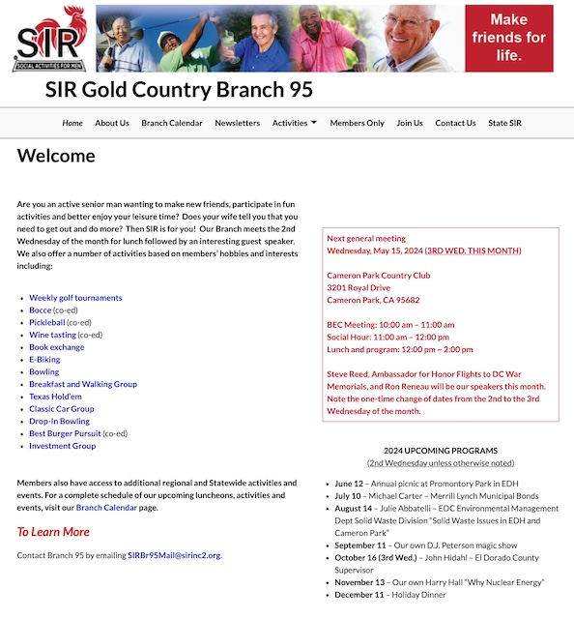
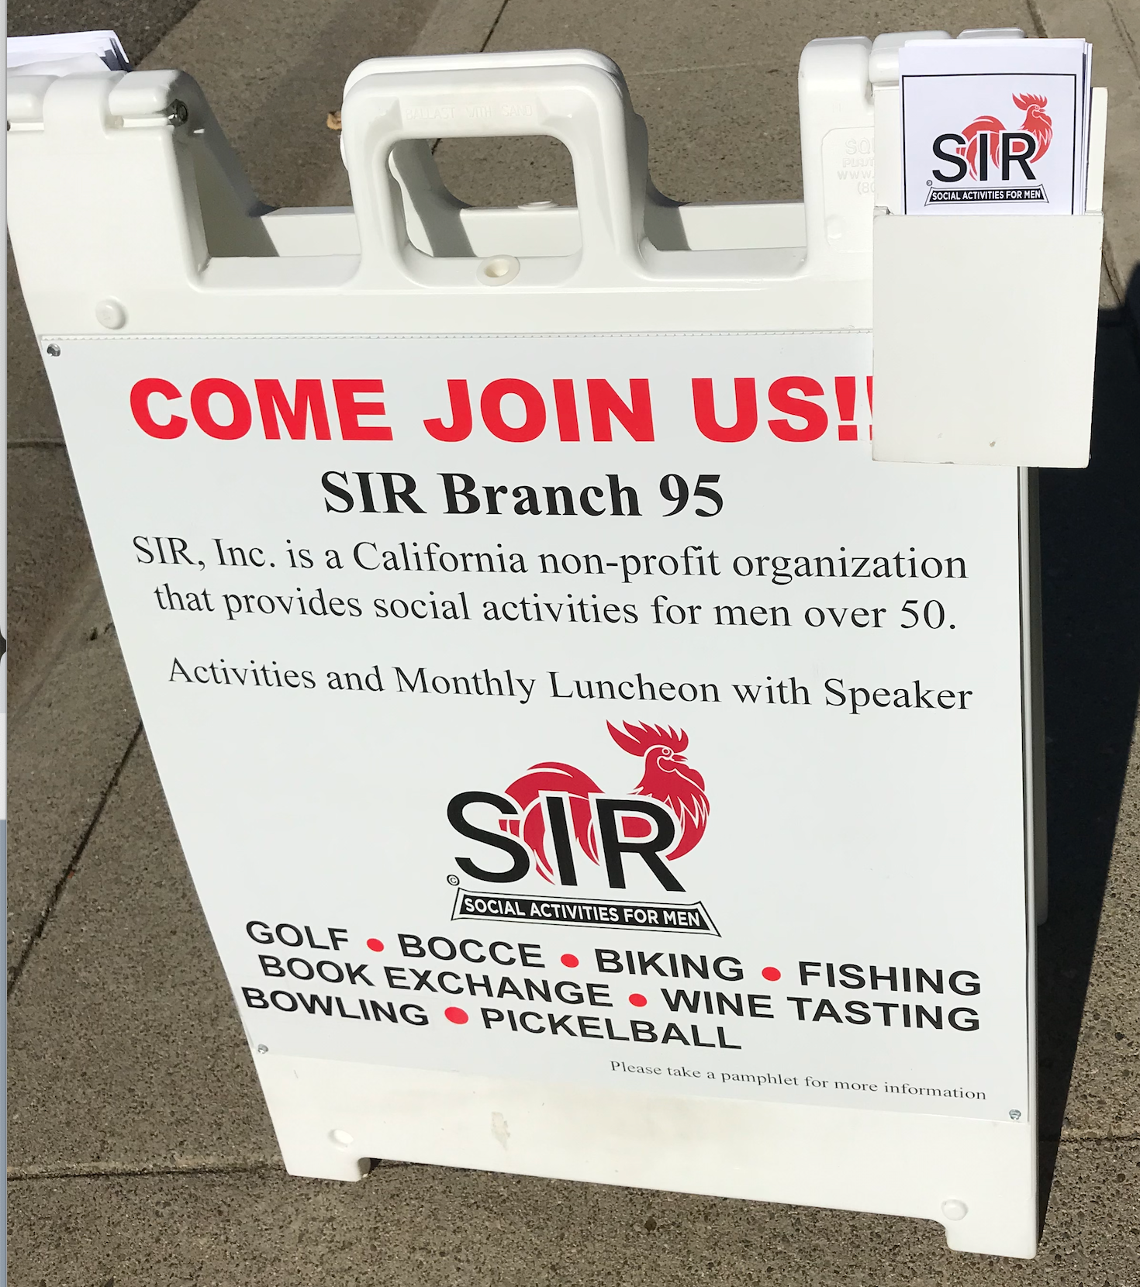
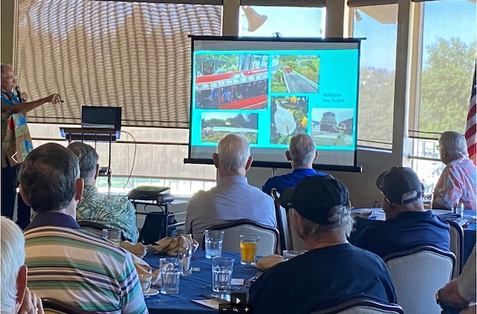
Attracting New Members – Advertising
Free, local print media; e.g., The Clipper, Style Magazine, Gold Panner, Around Here, The Hills Living, Village Life newspaper, etc.
Our BEC recently approved a small budget for paid advertising.
Branch email address to
request more information
Each form of advertising includes our web address for the prospective member to get more information about our branch
Branch Membership
Chairman
Branch email address
or web contact form
for more information
or to express interest
in joining
Complimentary lunch business card
Business flyer
Tri-fold with SIR and branch info (includes QR code on back)
Prospective Member
An up-to-date, robust website is essential; works 24x7x365
Sandwich board

Slide 6
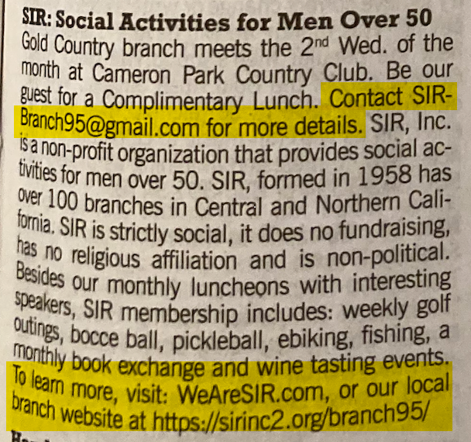
The Clipper
community notices section
An advertising publication direct mailed twice a month to 51,200 homes and businesses in El Dorado County

Slide 7
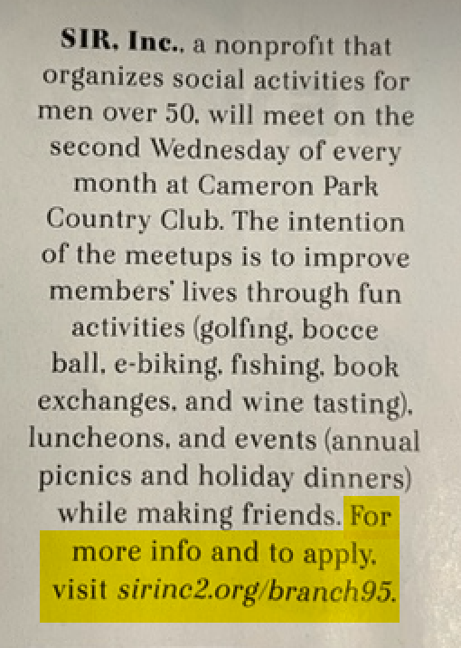
Style Magazine
Community Matters section
#What’s Up?
Monthly glossy direct mailed to 10,000 homes in Folsom and El Dorado Hills and distributed free at local restaurants and stores

Slide 8
Local Newspapers
Oldest newspaper in California, boasting continuous publication since 1851
Published weekly, covering news, sports, and features in El Dorado County

Slide 9
Business Flyer
Placed in local businesses
Shows members engaged in one of our lunches as well as some of the activities we offer
We want a prospective member to be able to see himself in one of these pictures

Slide 10
Complimentary Lunch Business Card
Given to each member to hand out to prospective members at their discretion
Provides prospective members a means of getting more information about SIR and our Branch

Slide 11
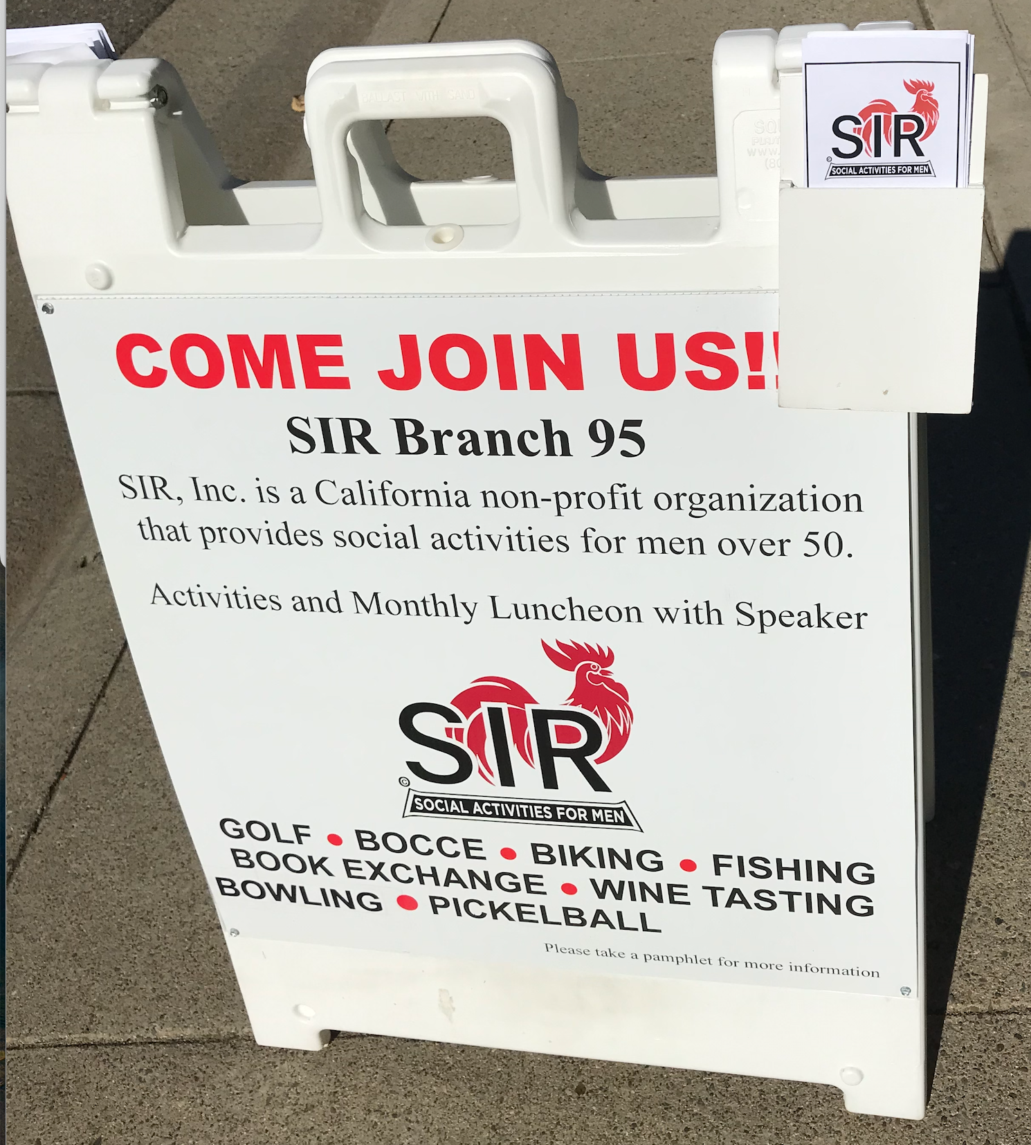
Sandwich Board with Tri-Fold Brochure
Placed outside of our meeting venue, clubhouses at our weekly golf tournaments and nearby at our other activities and events
Invites passersby to take a brochure which briefly describes SIR and our branch

Slide 12
Tri-Fold Brochure – 1 of 2
Provides details about SIR history as well as when and where our monthly meetings are held
Invites prospective members to come check us out by offering them a complimentary lunch

Slide 13
Tri-Fold Brochure – 2 of 2
Further describes SIR and our branch
Includes a list of our activities
Objective is to get prospective members to make contact with our Branch by email or through our website

Slide 14
Effectiveness of Advertising Campaign
SOURCE | MEMBERS
Unknown (left blank on application) | 43
Current members (word of mouth) | 40
Free local, print media | 8
Previous member from another branch; transfer from another branch; dual members | 8
Tri-fold brochure | 5
Web search of local SIR branches | 1
Word of mouth is a no cost and effective way of attracting new members
Unless it’s a friend or neighbor, the encounter may not be remembered

Slide 15
Attracting New Members – Web Presence
Free, local print media; e.g., The Clipper, Style Magazine, Gold Panner, Around Here, The Hills Living, Village Life newspaper, etc.
Our BEC recently approved a small budget for paid advertising.
Branch email address to
request more information
Each form of advertising includes our web address for the prospective member to get more information about our branch
Branch Membership
Chairman
Branch email address
or web contact form
for more information
or to express interest
in joining
Complimentary lunch business card
Business flyer
Tri-fold with SIR and branch info (includes QR code on back)
Prospective Member
An up-to-date, robust website is essential; works 24x7x365
Sandwich board

Slide 16
Our Website is the Focal Point of Our Approach
The internet is the first place many people look to for additional information
Works 24 x 7 x 365
Critical that it be professional looking and up-to-date
Likely the last chance to “sell” a prospect to connect with someone in the branch
Branch 95 website: sirinc2.org/branch95

Slide 17
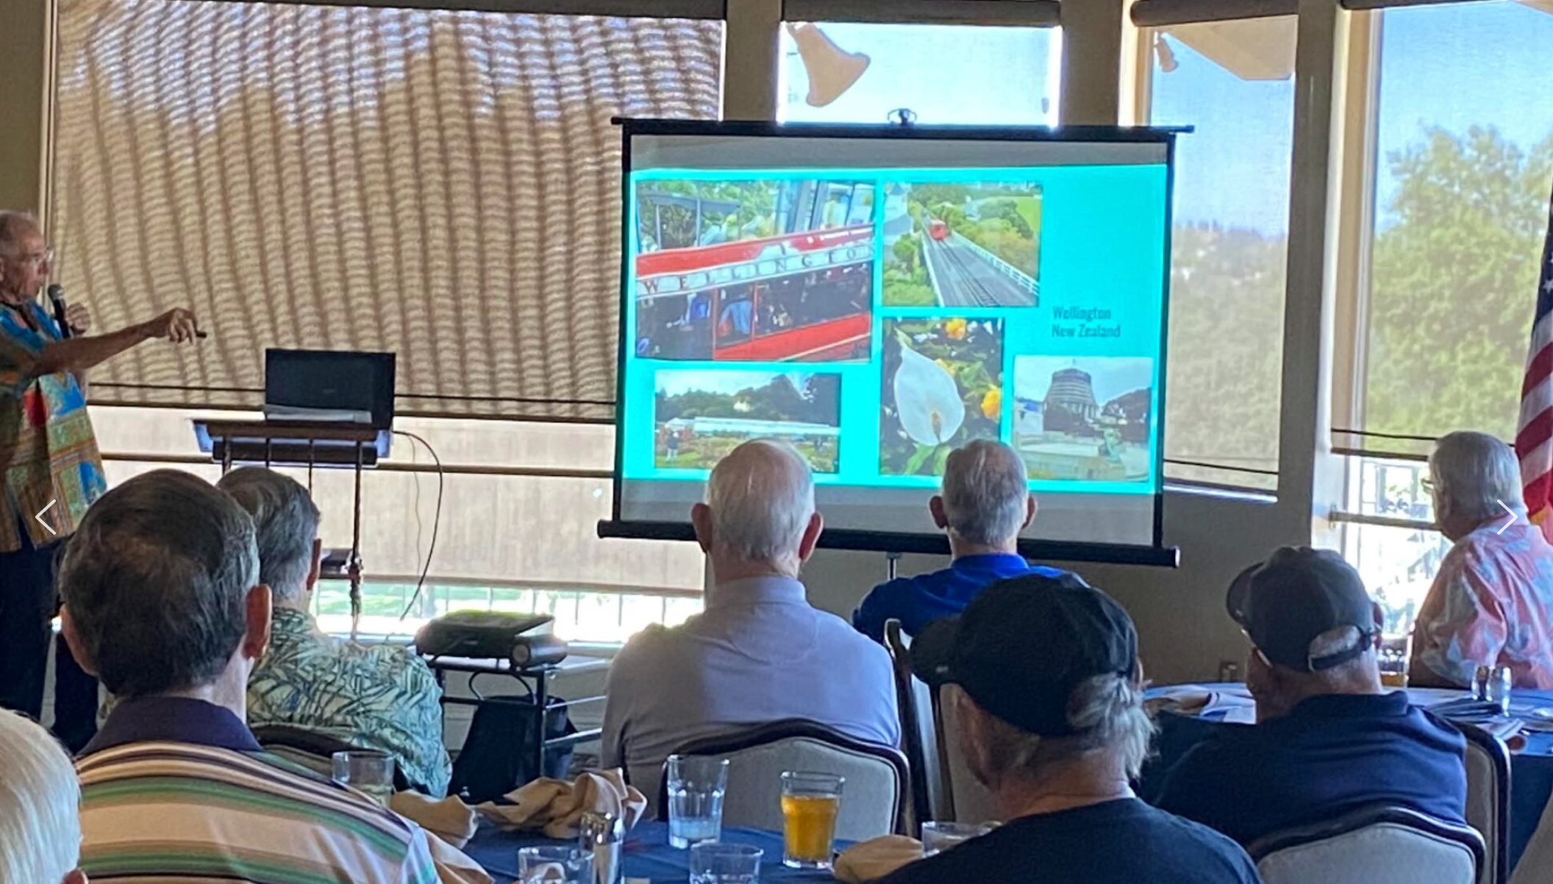
It’s All a Process…the Final Steps
Name badge with a dot signifying a new member
xxxx
New Member and Branch Member
Relations Chairman
Branch Membership
Chairman
Application Completed and Approved by BEC
Branch Activity Chairmen
Prospective
Member
Prospective Member is our guest at a branch meeting; receives a copy of our newsletter and a follow-up call

Slide 18
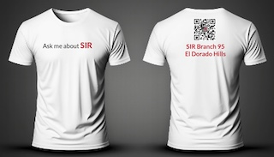
Other Ways Our Branch is Working and/or Exploring to Attract New Members
T-shirt marketing campaign
(developmental stages)
Paid advertising (new initiative)
Yard signs and social media (future)
Partnering with local realtors (future)
Partnering with four 55+ communities
(new initiative; developmental stages)
Senior Resource Fairs and other senior events
Expand our activity offerings through joint activities with nearby branches
Partnering with local senior center (challenges; see next slide)

Slide 19
Challenges in Attracting New Members
Local governments (e.g., park districts) and corporate HR departments who counsel new retirees view SIR as discriminatory and will not promote us
A common complaint is that the SIR name, while it has a long history, does not say what or who we are without having to say “Sons in Retirement” which was eliminated six years ago
The rooster has been described as “sexist”; “strange”; “outdated”; etc.
Lack of a coordinated, SIR-wide mass marketing approach
State SIR is seeking legal counsel and establishing an Advisory Committee to address ALL of these challenges

Slide 20
Recap and Wrap-up
Print media, signage, etc. are all relatively low cost, high impact tools for getting the word out about SIR and attracting new members
The branch website serves a central, critical role in the process
The goal should be getting the prospective member to make direct contact with the branch in order to trigger an ACTIVE, ONGOING conversation which may lead to lunch and, hopefully, a new member
Q&A

